Slide 1


1-2 MVC PATTERN
Maro Marčinko
Matija Hrženjak
IN2, 2017.

Slide 2
Sadržaj
Povijest i zašto se koristi
Detaljan opis i organizacija koda
Kako organizirati kod da odgovara toj arhitekturi.
Način implementacije u ASP.NET Mvc-u i WebAPI-au
Razne varijante Mvc patterna
Notes:
1) Povijest, zašto je i do danas najuspješniji pattern koji pomaže u razvoju čistih i održivih aplikacija.
2) Detaljan opis - prilika koja se mora iskoristiti za 3)
3) Kako organizirati kod da odgovara toj arhitekturi.
4) Razmišljanje - prikaz i način implementacije u Angular 1 controllera - servisa - viewa.
5) Razmišljanje - prikaz i način implementacije u ASP.NET Mvc-u i WebAPI-au
6) spomenuti varijantu MVVM za WPF aplikacije. Mini problematika pristupa (eventualno PRISM u 2-3 rečenice)

Slide 3
Any fool can write code that a computer can understand.
Good programmers write code that humans can understand.
Martin Fowler

Slide 4
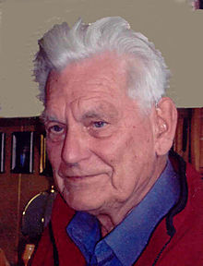
Povijest
Kreirao ga je Trygve Mikkjel Heyerdahl Reenskau
1979 godine
Inicijalno zamišljen za desktop razvoj – Smalltalk-76
1988 se pojavio kao koncept u The Journal of Object Technology
Koristio se u 80tim i 90tm
1996 – Apple’s WebObjects (Objective-C)
Danas se koristi na svim platformama
MV*W*
Notes:
Trygve Mikkjel Heyerdahl Reenskaug (born 21 June 1930) is a Norwegian computer scientist and professor emeritus of the University of Oslo. He formulated the model–view–controller (MVC) pattern for graphical user interface (GUI) software design in 1979 while visiting the Xerox Palo Alto Research Center (PARC). His first major software project, "Autokon," produced a successful CAD/CAM program which was first used in 1963, and continued in use by shipyards worldwide for more than 30 years.
MVC was conceived as a general solution to the problem of users controlling a large and complex data set.

Slide 5
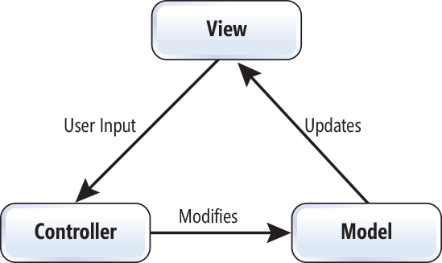

Mvc Pattern
Softverski arhitekturalni pattern koji pomaže u kvalitetnoj implementaciji User Interfacea
Notes:
s, MVC became one of the first approaches to describe and implement software constructs in terms of their responsibilities.^{[9]}
The single responsibility principle states that every module or class should have responsibility over a single part of the functionality provided by the software, and that responsibility should be entirely encapsulated by the class. All its services should be narrowly aligned with that responsibility. Robert C. Martin expresses the principle as, "A class should have only one reason to change."^{[1]}
^{Coupling!}
In computer programming, cohesion refers to the degree to which the elements inside a module belong together.^{[1]} Thus, cohesion measures the strength of relationship between pieces of functionality within a given module. For example, in highly cohesive systems functionality is strongly related.
Cohesion is an ordinal type of measurement and is usually described as “high cohesion” or “low cohesion”. Modules with high cohesion tend to be preferable, because high cohesion is associated with several desirable traits of software including robustness, reliability, reusability, and understandability. In contrast, low cohesion is associated with undesirable traits such as being difficult to maintain, test, reuse, or even understand.

Slide 6
Mvc Pattern
Glavne kompoment
Model - nezavisni aplikacijski objekt koji sadrži dio domenske reprezentacije (ponekad i validacije i logike). Domenska logika i obrada podataka
View – ekranska reprezenacija podataka. Za isti model možemo imati više vrsta viewova
Controller – definira sve akcije-komande koje sistem može zaprimiti. Šalje zahtjeve za pretvorbom domenskih podataka u podatke za prikaz. Prihvaćanje korisničkih akcija.
ViewModel – konverzijom jednog ili više domenskih objekata u specifični ekranski model, postižemo fleksibilnost i neograničene mogućnosti prezentacije
Notes:
Before MVC, user interface designs tended to lump
these objects together. MVC decouples them to increase flexibility and reuse.
MVC decouples views and models by establishing a subscribe/notify protocol between
them. A view must ensure that its appearance reflects the state of the model.
Whenever the model's data changes, the model notifies views that depend on it.
In response, each view gets an opportunity to update itself. This approach lets
you attach multiple views to a model to provide different presentations. You can
also create new views for a model without rewriting it.

Slide 7
Mvc Pattern
UI logika-aplikacija se dijeli u tri povezana dijela, tako da se interna reprezentacija apstrahira od prezentacije korisniku ili zaprimanja od korisnika
MVC pattern omogućava da se model klase „ponovno iskorištavaju” bez promjena SRP (Single Responsability Principle) na djelu

Slide 8
Prednosti
Timski rad
Moguće podijeliti posao za pojedini sloj
Moguće podijeliti posao po logičkoj cjelini
Loose coupling
Lagano zamijeniti pojedini dio
Lako nadograditi
Moguće imati više Viewova za isti model
Device specific view

Slide 9
Organizacija koda
public HttpResponseMessage GetOrderDetails(string orderId)
{
try
{
var user = _userService.GetCurrentUser();
var order = _ordersService.GetOrderDetails(orderId);
return Request.CreateResponse(HttpStatusCode.OK, order.ToOrderModel(user.IsClubMember));
}
catch(Exception exc)
{
_logger.Error("Order Details error", exc);
return Request.CreateResponse(HttpStatusCode.InternalServerError);
}
}

Slide 10
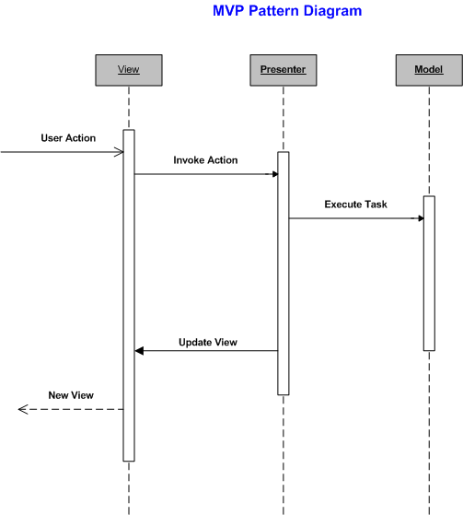
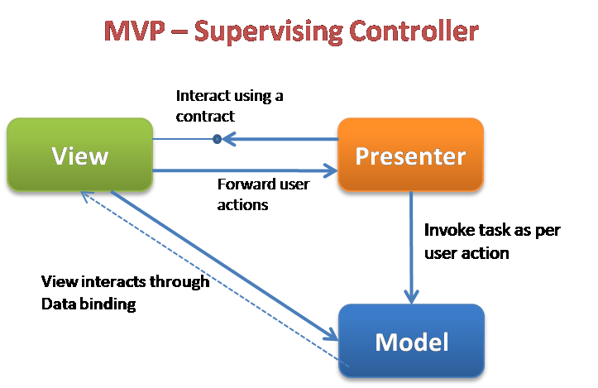
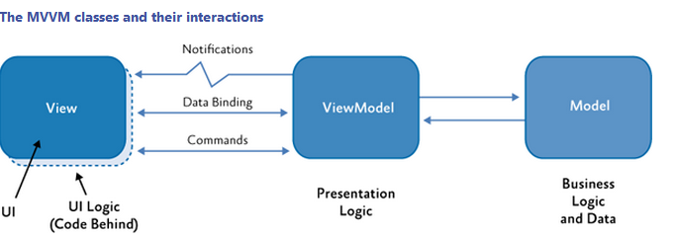
Varijante
Model – View – Presenter
Model – View – ViewModel (PRISM)

Slide 11


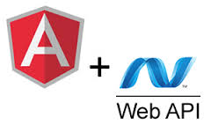
Koristi se

